Slide 1

Anomaly-aware clinical detection system
Team Magma: Mauricio Bermudez, Alvaro Montoya Ruiz, Hriday Reddy Purma

Slide 2

Problem Reinforcement
Management of chronic conditions, in this case diabetes can be challenging. This is due to EHRs being fragmented.
Blood Glucose spikes can be buried under lab results and discharge notes.
During our investigations, we did not identify any systems that automatically detect anomalies and then provide summarizations.
Our project aims to solve this, by building an automatic blood sugar anomaly-detection system.

Slide 3
Motivation
By addressing these issues, we hope to address clinical burnout which is all too common due to administrative tasks, such as in-depth review of clinical notes.
A sufficiently optimized model can also potentially save time on a per patient record basis.
Can double as an early-warning system. Faster identification of these anomalies can lead to faster preventative care.

Slide 4
Data and Feasibility
MIMIC-III: Curated Data for Describing Blood Glucose Management in the Intensive Care Unit.
1
MIMIC-III: Clinical Database
2
MIMIC-IV: Clinical Database utilized to help further fine-tune our model on unstructured notes.
3
Compliance: We must adhere to HIPAA protocol and preventing ourselves from seeking to identify patients in the datasets.
4

Slide 5
Plan and Methodology
The RAE detects anomalies in time-series glucose data from MIMIC-III, identifying abnormal timestamps and associating them with relevant clinical notes.
Finally, clinical notes associated with anomalies (outputted by the RAE) are processed by the fine-tuned BART model to generate concise summaries, enhancing the interpretability and explainability of abnormal glucose readings.
Leveraged clinical notes from MIMIC-IV to generate ground truth summaries using the PEGASUS model, providing high-quality reference summaries.
Fine-tuned a BART model on the MIMIC-IV notes paired with PEGASUS-generated summaries to improve summarization performance.
Architecture Pipeline
Clinical Notes MIMIC 4
Glucose Readings
Ground truth summaries using PEGASUS
Anomaly Detection with RAE
BART Fine Tuning Process
Anomalies Stored (GLC and notes)
Explainable Notes for Anomaly GLC metrics

Slide 6
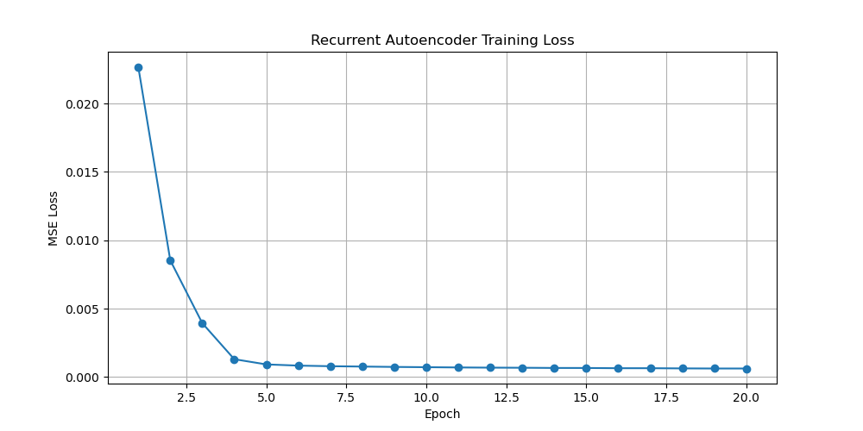
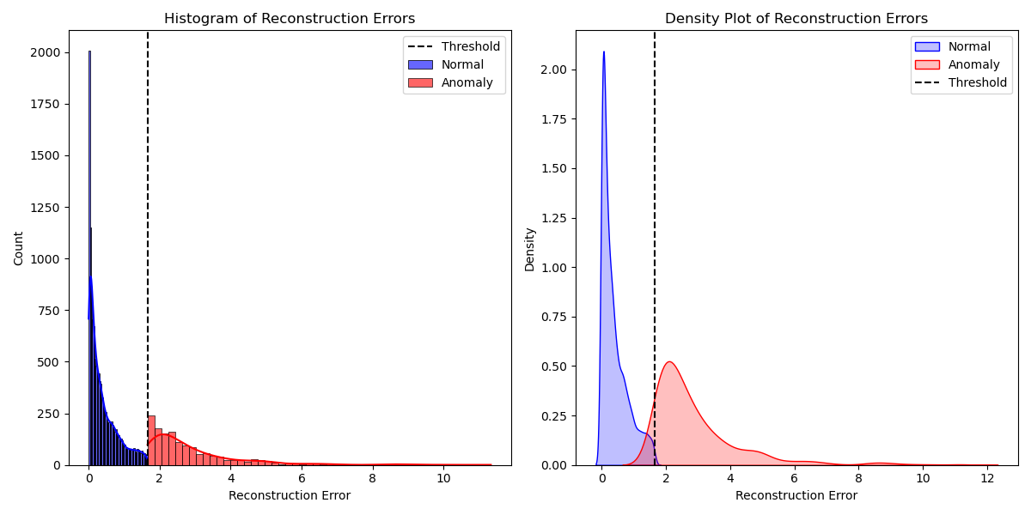
Anomaly Detection Outcomes - RAE

Slide 7
Output – Summarization
PATIENT NOTES FOR ANOMOLY VALUE:
[**Known lastname **] is a 61-year-old insulin-dependent diabetic type I, with history of coronary artery disease, transferred from [**Hospital1 **] [**Location (un) 620**] by life flight for DKA associated with chest pain. The patient checked his blood sugar and it was 500. He was given 2 g of calcium gluconate, 10 units of IV insulin, 50 of bicarbonate, and an aspirin. Patient's glucose remained 500. insulin, and the rate of his insulin drip was increased to 10/hr. However, his glucose remained critically high. He endorses thirst and polyuria. [**Known lastname **] is a 61-year-old insulin-dependent diabetic type I, with history of coronary artery disease, transferred from [**Hospital1 **] [**Location (un) 620**] for DKA associated with chest pain. Anion gap on admission 17. Patient was bolused with insulin in the ICU. His insulin drip was titrated up and his blood sugar values decreased. While in ICU, anion gap closed, glucose remained between 150-200 and patient was weaned off drip to S.C. Once the patient was stablized, he was seen by the [**Last Name (un) **], who recommended a more stringent insulin regimen given his level of insulin resistance. He is being discharged on a [**Last Name (un) **] 70units after breakfast and sliding scale insulin with Humalog at meals and before bedtime. *Insulin regimen should be adjusted, possibly splitting up [**Last Name (un) **] dose, as does spike to glucoses in the 200-300 range in the afternoons. K+ repleted to keep between 3.3 and 5 while correcting DKA. #Cognitive deficits: He has had episodes of DKA in the past, and this episode appears to have been precipitated in part by lack of taking his lantus. He was given D5 1/2NS with insulin drip which was changed to D5W and encouraged free water intake. Insulin regimen may need adjustment to achieve better day time euglycemia. 17. insulin [**Month/Day/Year **] 100 unit/mL Solution Sig: Seventy (70) Units Subcutaneous qam. You were treated with insulin and fluids in the intensive care unit, and after your condition stabilized you were transferred to the regular medical floor.
BART (Fine-tuned) MODEL OUTPUT:
Insulin regimen may need adjustment to achieve better day time euglycemia. [**Known lastname **] is a 61-year-old insulin-dependent diabetic type I

Slide 8
Challenges
Unstructured Clinical Notes - Raw notes were lengthy and poorly formatted, requiring preprocessing before being input to the RAE model.
BioBert was not suitable for applying summarization tasks on the code. PEGASUS was used as an alternative to generate ground truth summaries.
RAE Anomaly Detection Nuances - LSTM RAE identified anomalies based on sequence patterns rather than absolute glucose values. Resulted in occasional misclassifications (e.g., some high GLC values not flagged, some normal readings included).
PEGASUS Summary Quality Issues - Some generated summaries were short or included hallucinated content using article structure. Data filtering and cleaning steps were applied to enhance summary relevance.

Slide 9
Literature
Arndt, B. G., Beasley, J. W., Watkinson, M. D., Temte, J. L., Tuan, W.-J., Sinsky, C. A., & Gilchrist, V. J. (2017). Tethered to the EHR: Primary Care Physician Workload Assessment Using EHR Event Log Data and Time-Motion Observations. The Annals of Family Medicine, 15(5), 419–426. https://doi.org/10.1370/afm.2121
01
Paula, P. A. B. de, Severino, J. V. B., Berger, M. N., Veiga, M. H., Ribeiro, K. D. P., Loures, F. S., Todeschini, S. A., Roeder, E. A., & Marques, G. L. (2025). Improving documentation quality and patient interaction with AI: A tool for transforming medical records—an experience report. Journal of Medical Artificial Intelligence, 8(0), Article 0. https://doi.org/10.21037/jmai-24-213
02

Slide 10
Thank you!
The End

Slide 11

Q & A

